Slide 1
Northern university bangladesh
Course Code: CSE 4177
Course title: Computer Peripheral and Interfacing Lab Work
Smart Classroom
Arduino-based Automation, Attendance & Safety System
Lamisa Yeasmin Nakia
Id:41230100795
Aminul Islam
Id:41230100697
Hanifa Ismin Nila
Id:41230100722

Slide 2

Overview of Tinkercad for Classroom Design
Tinkercad is a user-friendly platform that enables designing smart classroom models effectively. By allowing 3D modeling, educators can visualize essential components like seating arrangements and technology integration.

Slide 3
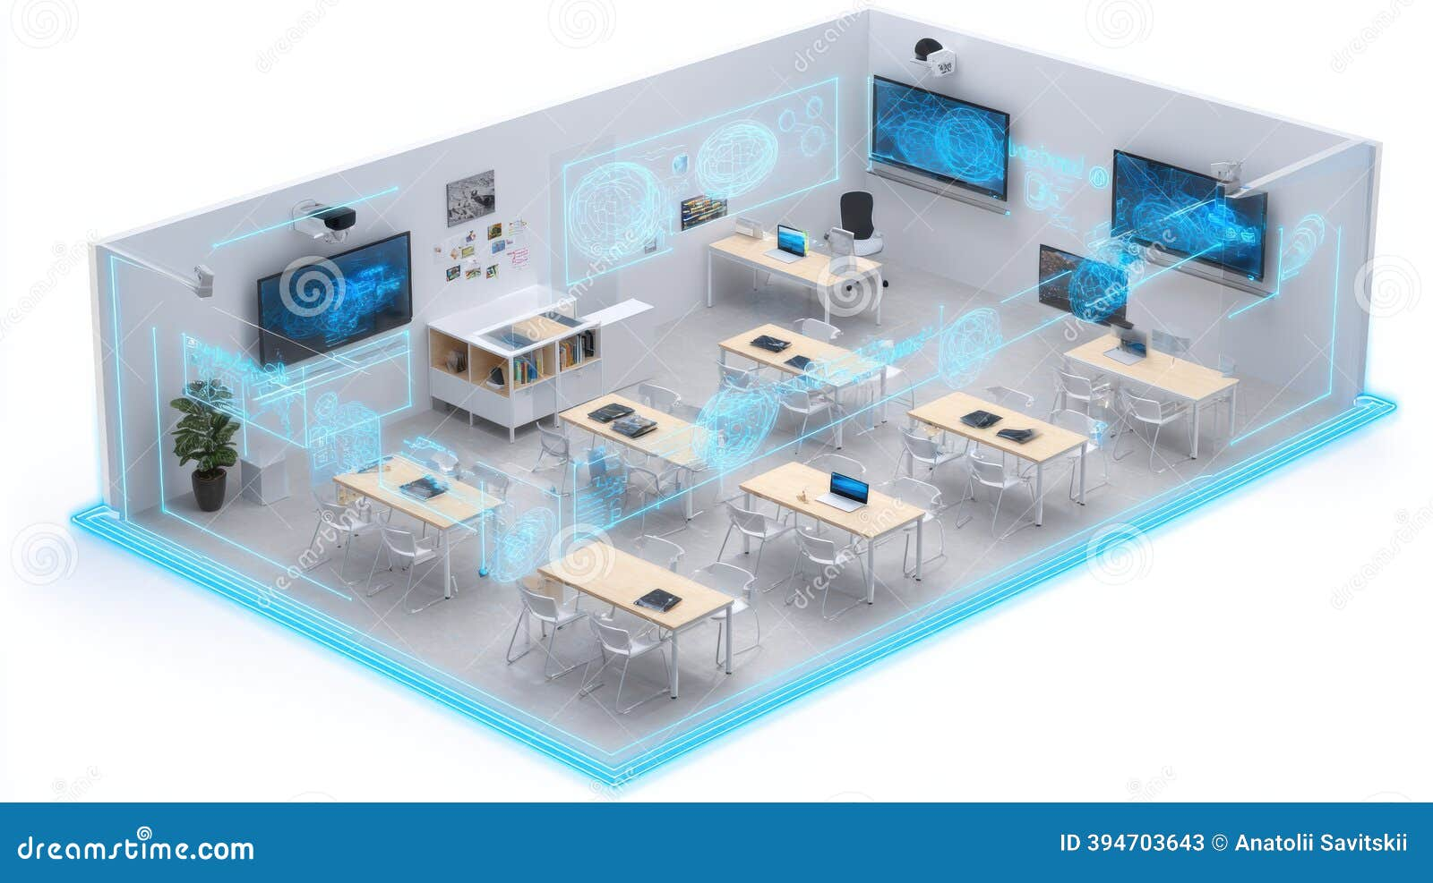
Objectives:
• Automate attendance system
• Secure entry for registered students
& teachers.
• Fire/smoke detection & alert
• Temperature-based AC control
• Real-time updates on LCD screen

Slide 4
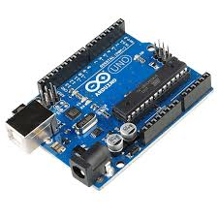
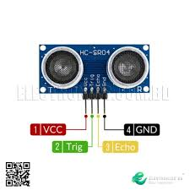
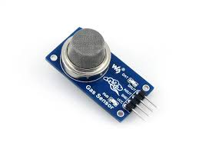
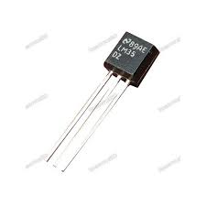
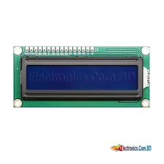
Components used
• Arduino UNO (controller).
• Servo Motor (door lock system).
• Ultrasonic Sensor (detects presence).
• LM35 Temperature Sensor (room temp).
• Gas Sensor (fire/smoke alert).
• LCD (16x2 I2C) (displays data).
• DC Motor (AC/Fan simulation).
• Buzzer + LEDs (alerts).

Slide 5
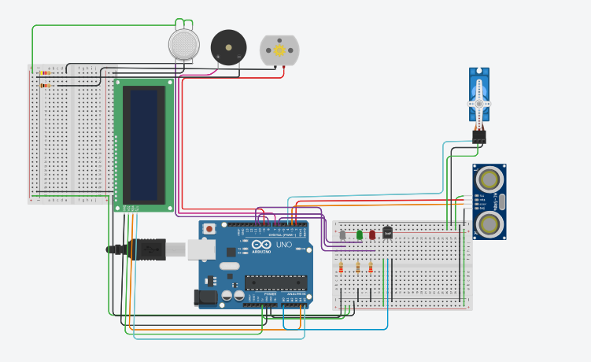
Tinkercad simulation image:

Slide 6
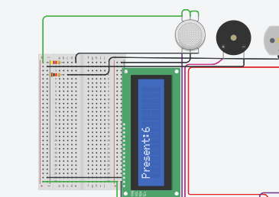
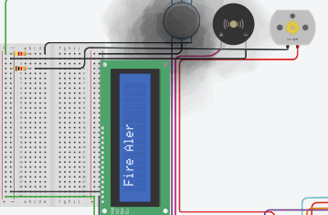
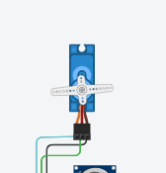
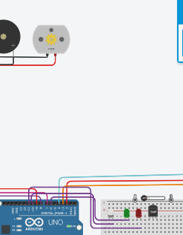
Working principle
Attendance → via Serial ID check
• Door → Servo + Ultrasonic
• Temperature → Fan ON if > 30°C
• Fire Alert → Gas sensor → Buzzer + Red LED + Door open
• LCD → Shows status (attendance, alerts, messages)

Slide 7
Difficulties
• Limited Arduino memory for many IDs.
• Sensors not always accurate (false alarms, interference).
• Power issues: Components need stable 5V supply.
• Servo moves irregularly due to insufficient current.
• Serial input for IDs not practical in real classrooms.

Slide 8
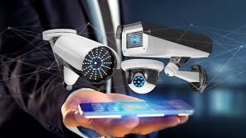
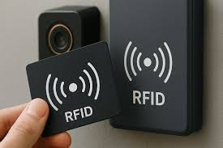
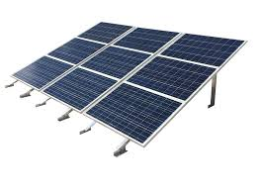
Future Possibilities
• Replace Serial ID with RFID/Face Recognition
• IoT / Cloud for remote monitoring
• Mobile app for teachers to track attendance & alerts
• Integration with CCTV & AI analytics
• Solar/battery backup for reliability

Slide 9
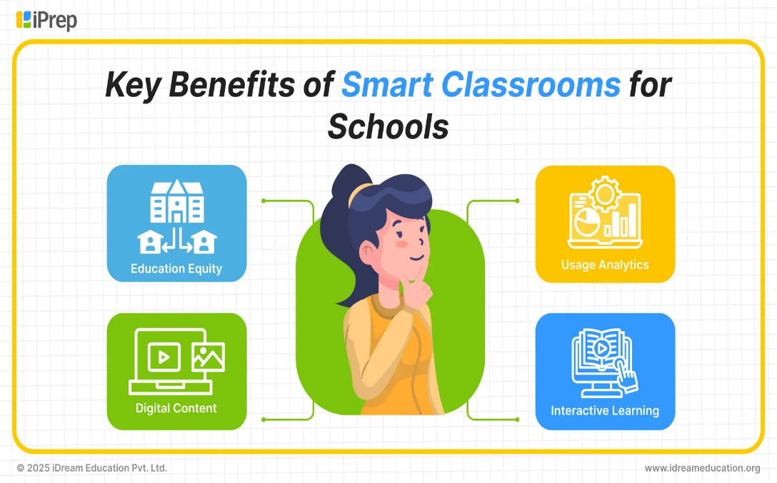
Advantages
• Reduces manual work (attendance & monitoring)
• Improves safety with fire alerts
• Saves energy with automatic AC/fan control
• Real-time info on LCD

Slide 10

Conclusion
• A cost-effective smart solution for classrooms
• Improves security, safety & comfort
• Can be upgraded to IoT-based smart campus system

Slide 11


